Slide 1
Problem Statement
Internship

Slide 2
Physical topology
G(N,E) => N = number of vertexes(~ 100-200) and E = number of edges(~200-300)
Every edge has multiple channel (~100), we can consider it Multiple edge in point of view in graph theory.
Every edge use a metric which we can call it Distance

Slide 3
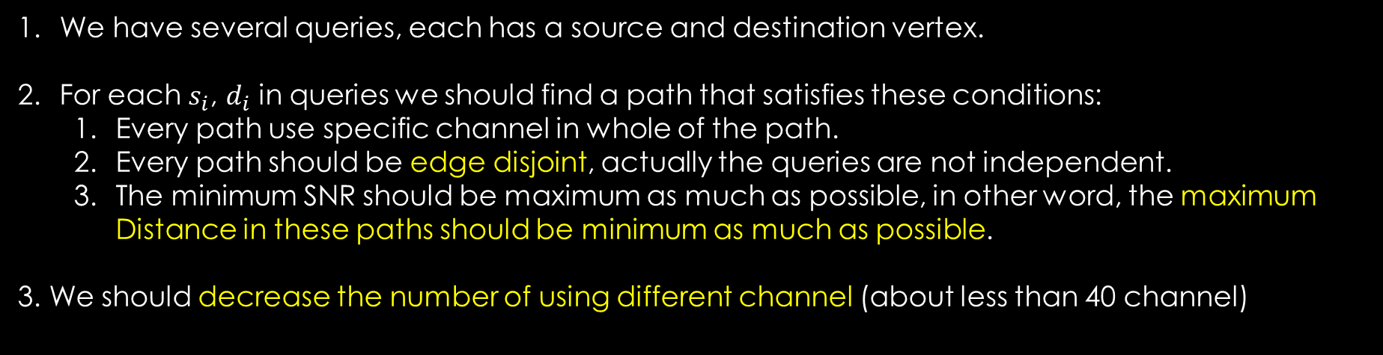
Objects
We have several queries, each has a source and destination vertex.
For each $s_{i}$, $d_{i}$ in queries we should find a path that satisfies these conditions:
Every path use specific channel in whole of the path.
Every path should be edge disjoint, actually the queries are not independent.
The minimum SNR should be maximum as much as possible, in other word, the maximum Distance in these paths should be minimum as much as possible.
3. We should decrease the number of using different channel (about less than 40 channel)

Slide 4
New Problem (extended version)
We have a clustered vertexes in every cluster we have a vertex as Gate
The problem should satisfy previous objects but in one different:
1. when we want change the cluster in our path we should go out by Gate and once we want to enter another cluster we should enter also with its Gate.
2. we can change the channel in the Gate and we can not change it along the path between Gate’s vertex.
See the example in next slide

Slide 5
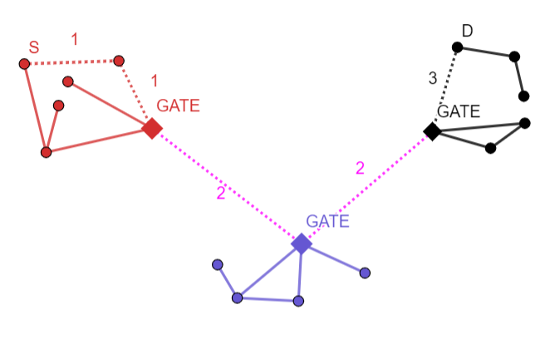
The path between S and D (the number on the edges is the channel number which use on that edge, It is not distance)

